Slide 1
Project Title
Superstore Sales Analysis Dashboard
Prepared by: Christabel Ifeanyichukwu
Tool: Microsoft Power BI

Slide 2
Dataset Overview
Superstore Sales dataset (2014–2017)
Retail sales, customers, products and profit.

Slide 3
Business Problem
Analyse sales performance, profitability and customer behaviour.

Slide 4
KPIs Defined
• Total Sales
• Total Profit
• Orders
• Customers
• Profit Margin
• Average Order Value
• Quantity
• Products

Slide 5
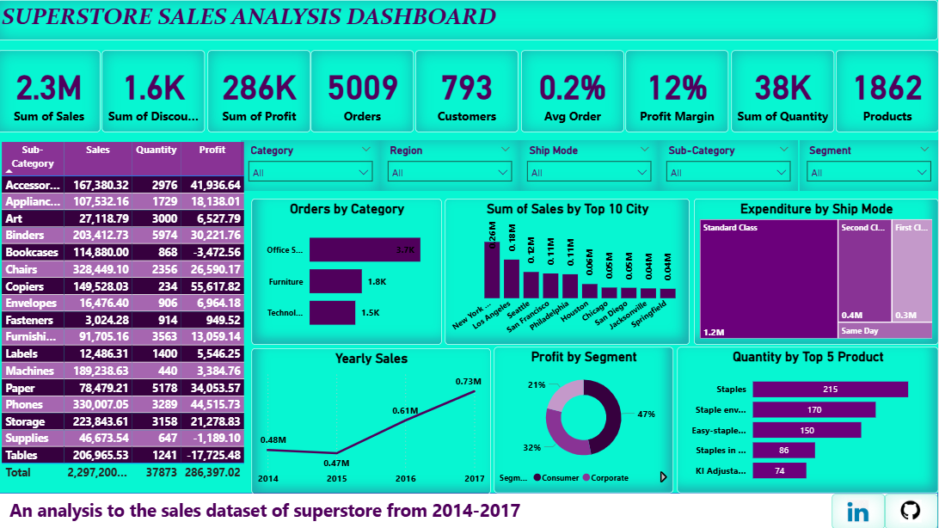
Dashboard Screenshot

Slide 6
Key Insights
• Sales grew overall.
• Office Supplies had high order volume.
• Standard Class dominated shipping.

Slide 7
Recommendations
• Focus on profitable products.
• Review discount strategy.
• Optimise shipping.

Slide 8
Challenges Faced
• Data preparation.
• DAX calculations.
• Dashboard layout and storytelling.

Slide 9
Conclusion
This dashboard provides interactive insights to support data-driven decision-making.

